Slide 1

Liquid State Machine for TI46 Dataset
EE746 - Neuromorphic Engineering Project
Anuranan Das, 18D070037
Adil Khan 18D070036
Aseer Ansari 18D070040
CODE Base : https://github.com/AnDa-creator/EE746-NeuromorphicEngineering

Slide 2
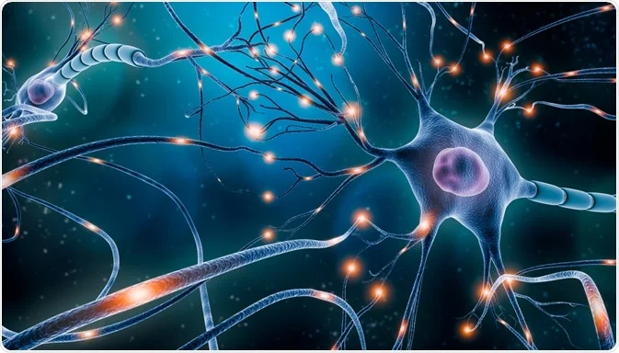
Outline
01
Overview
Preprocessing , Input Neurons, Reservoir Structure, Reservoir Visualization, Readout Neurons, STDP, Training
02
Results
Static synapses , First-order synapses
Second-order synapses, Conclusion
03
Using SVM Classifier
Static synapses, First-order synapses,
second-order synapses, SVM without reservoir, Conclusion
04
References
Notes:
© Copyright PresentationGO.com – The free PowerPoint and Google Slides template library

Slide 3
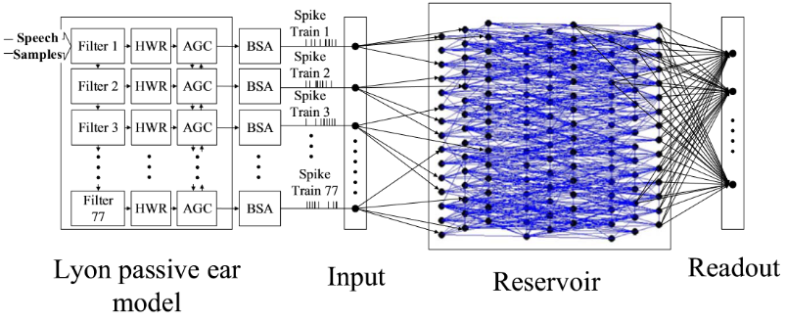
Overview of the System
Input samples
Network Interconnects
LIF Neuron
Preprocessing
Analog filters and encoders
Cochlear model
Overall System
The preprocessed input is given as input to the input neurons.
The LSM is implemented as an overall ensemble of three procedures.
Reservoir
TI-46 wav samples
The input neurons are connected to the neurons in reservoir via synapses.
Input spike trains
Reservoir spike data
Classifier
Classifier Output
The Readout layer is also connected to the reservoir via plastic synapses whose weights are learned during training.
Notes:
© Copyright PresentationGO.com – The free PowerPoint and Google Slides template library

Slide 4
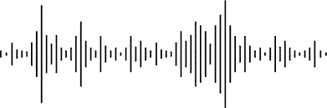

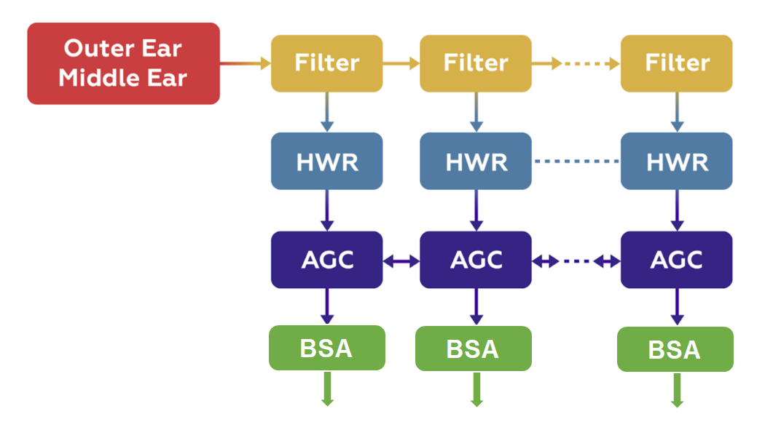
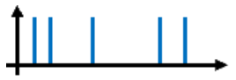

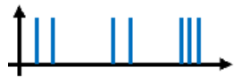
Preprocessing
TI-46 input as Audio waveforms
Lyon’s Passive Ear Model
Ben’s Spiker Algorithm (BSA)
Each sample gives 78 spike trains (channels)

Slide 5
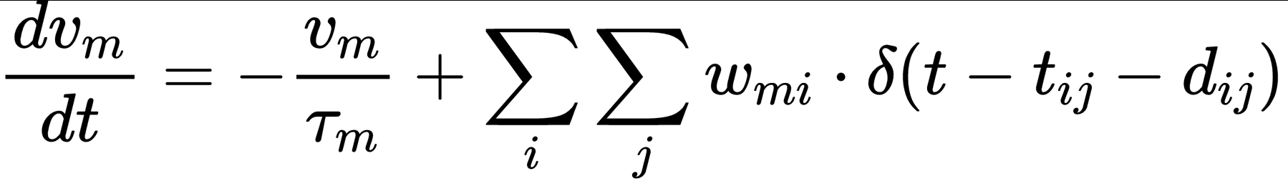


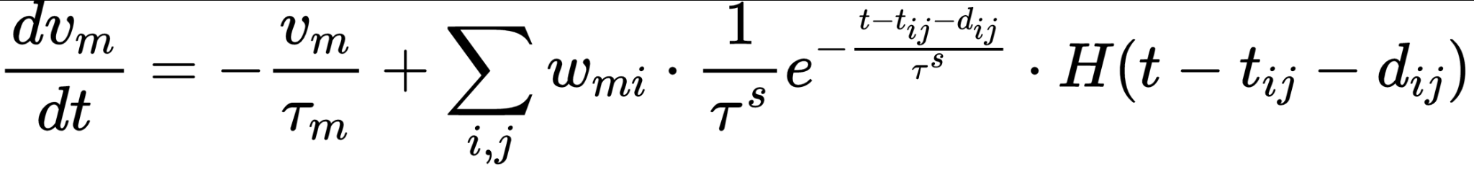
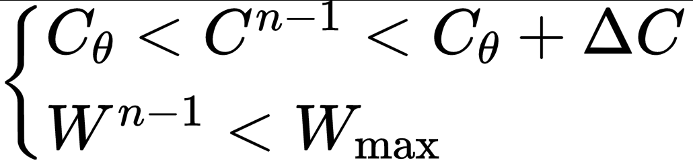
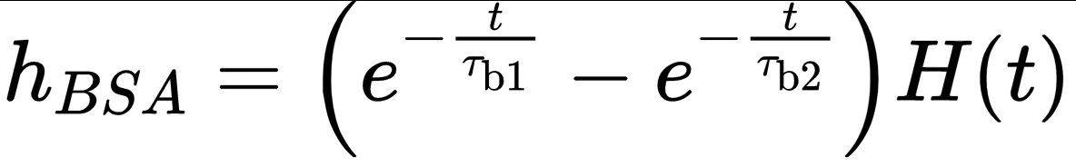

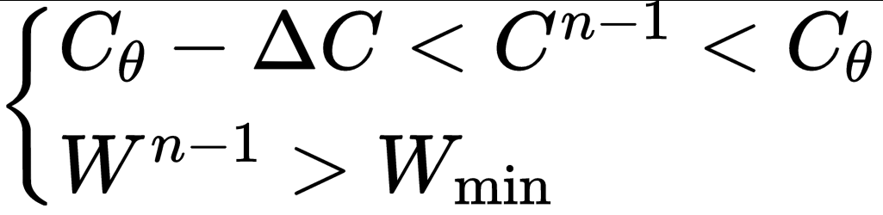
Micromodels used in simulations
LIF Neuron
Synapses
Calcium dynamics
Used for Readout and reservoir neurons
Three model used were →
And also 2nd order ...
The dynamics of calcium concentration c is
Learning rule(STDP)
BSA encoder
Teacher current
Weight increment :
Weight decrement :
The teacher current expressions used were as follows:
Analog signal converted to spike train using BSA
Notes:
© Copyright PresentationGO.com – The free PowerPoint and Google Slides template library

Slide 6
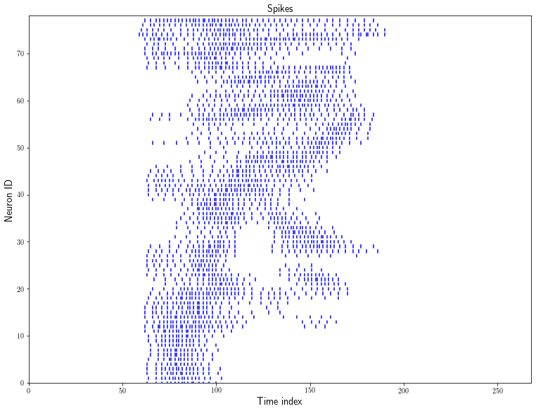
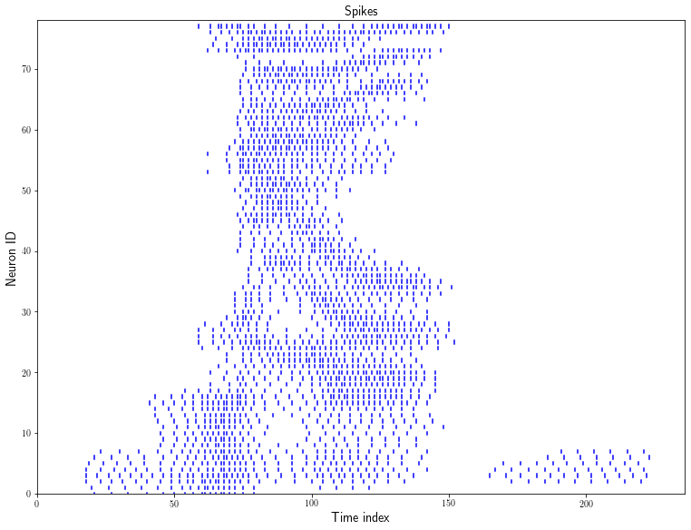
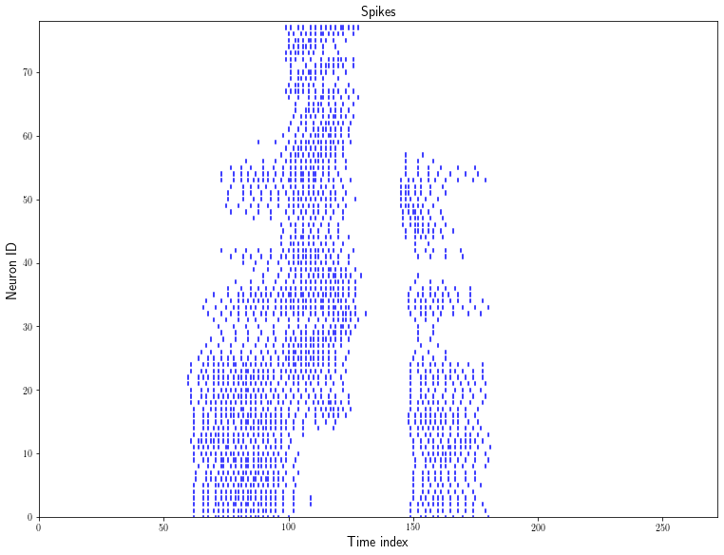
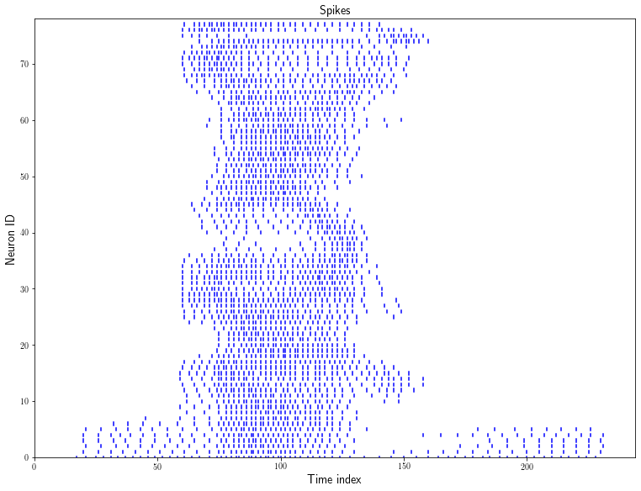
Input Neurons
The preprocessed input is a spike train, which is taken as the spikes in the input layer.
Total 78 neurons are taken in the input layer.
Each neuron is connected to 4 neurons in the next layer (Reservoir).
Weight of each synapse is 8, and each synapse is excitatory or inhibitory with probability of 0.5 .
Zero
Three
Six
Nine
Input Raster for various classes

Slide 7
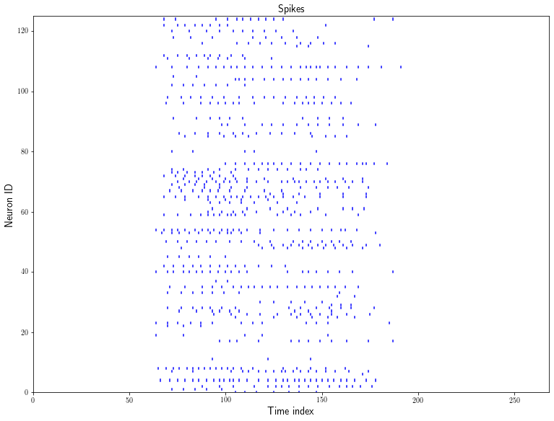
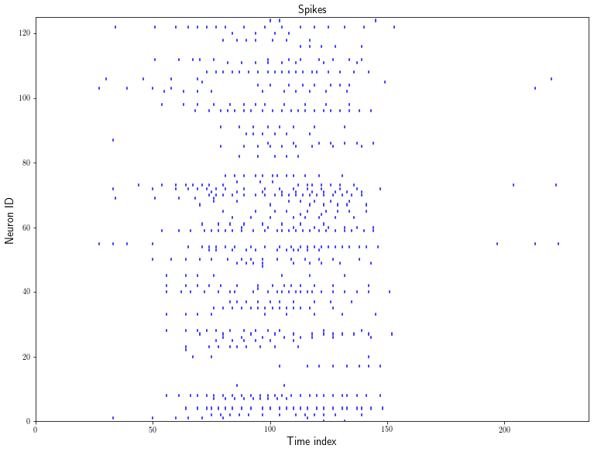

Reservoir Structure
The shape of the reservoir is taken as 5x5x5.
The connection probability between 2 neurons N1,N2 is given by:
80% neurons are taken as excitatory, 20% inhibitory.
The synapses can be static, first-order or second order.
Zero
Three
Response to Zero
Response to Three
Reservoir responses for various sample inputs

Slide 8
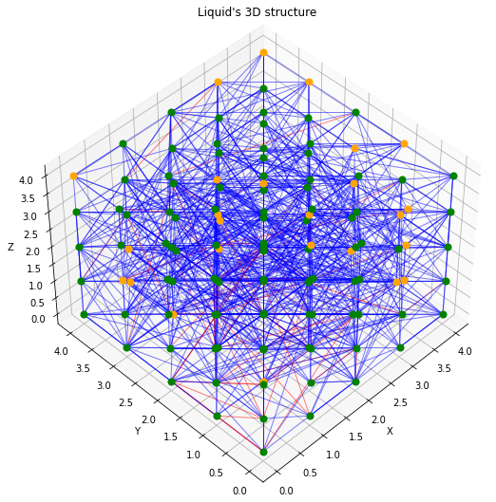
Reservoir Visualization
5✕5✕5 reservoir
Excitatory neuron
Inhibitory neuron
Excitatory synapse
Inhibitory synapse
Total number of synapses in the reservoir 1130
Connection-wise:
Excitatory→excitatory:769 (Weight = 3)
Excitatory→inhibitory:105 (Weight = 6)
Inhibitory→Inhibitory/Excitatory:256 (Weight = -2)

Slide 9
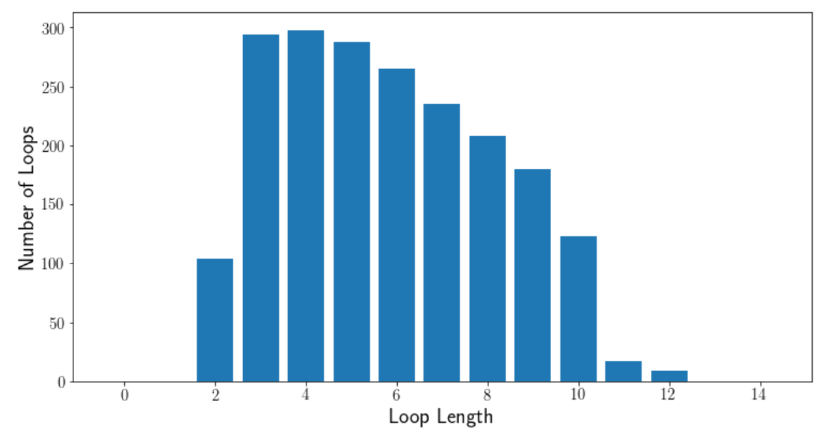
Loops Visualization
5✕5✕5 reservoir
Number of loops for a given loop length (number of nodes in a loop)
This is loosely related to the time duration for which delayed coincidence may affect output

Slide 10
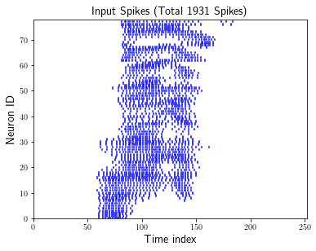
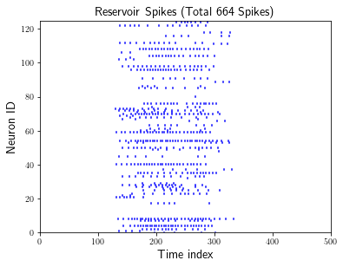
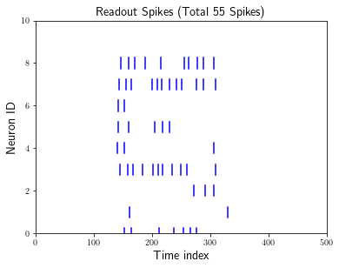
Readout Neurons
Each readout neuron is connected to all the neurons in the reservoir.
Total 10 readout neurons are considered, corresponding to 0 - 9 digits.
The class of a given input is decided by the readout neuron with most spikes.
Predicted Label: 7 Actual Label: 7

Slide 11
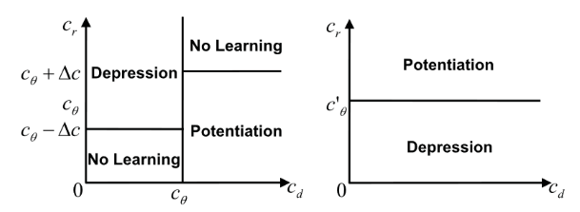
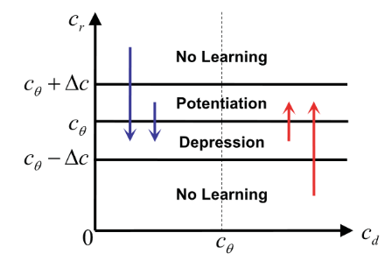
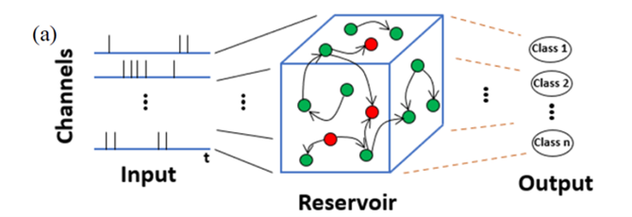
Bio Inspired Learning
There are 10 output neurons(1 for each class) and the one with higher no.of spikes is chosen as the class for given input.
Each readout neuron is connected to all the reservoir neurons by plastic synapses.
During training we teach the neuron with high current values so as to trigger weight changes for certain synapses tailored to a particular input. The decision of changing weights is based upon the variation of calcium concentration in the readout neurons.
The range of the weights is taken to be -8 to 8, with a step size of 0.001. Weight update happens with a probability of 0.1.

Slide 12
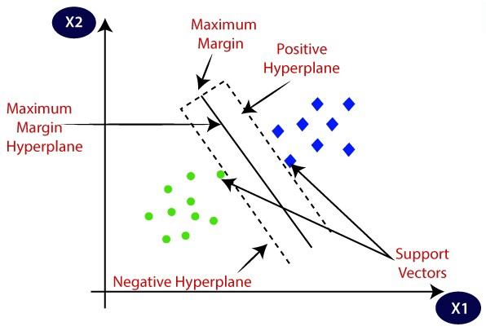
SVM Classification
Instead of the Readout layer, the total number of spikes in each neuron of the reservoir can be taken as the input and given to an SVM classifier with linear kernel.
This can be done for all the 3 types of synapses.

Slide 13
Results

Slide 14
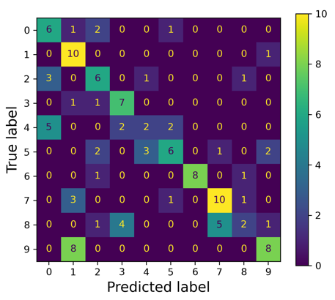
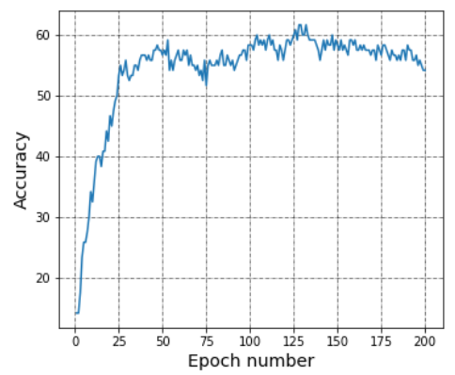
Using Static synapses
Maximum Accuracy obtained is 61.67%.

Slide 15
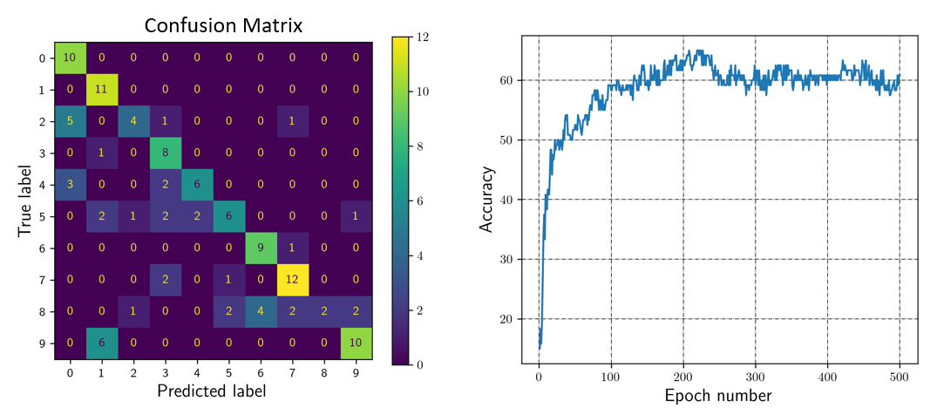
Using First-Order synapses
Maximum Accuracy obtained is 65%.

Slide 16
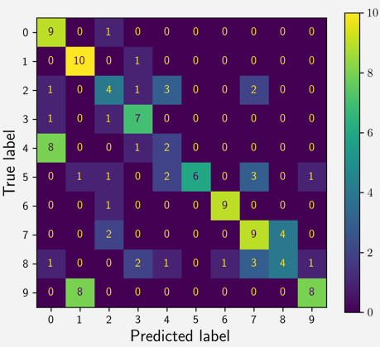
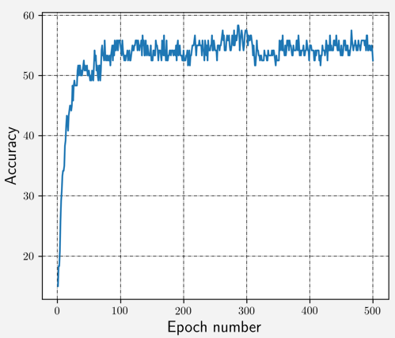
Using Second-Order synapses
Maximum accuracy obtained was 58.33 %

Slide 17
Conclusion
We were not able to obtain high accuracies as mentioned in the references.
The accuracies obtained however remained consistent after reaching the points very early, nature wise they were similar to the curves illustrated in papers.

Slide 18
Using SVM Classifier

Slide 19
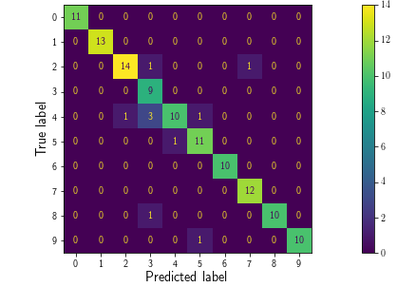
SVM classification with static synapses
Confusion Matrix
Total number of spikes in each neuron of the reservoir is taken as the input.
SVM with linear kernel is used for classification.
Accuracy obtained is 91.67%.

Slide 20
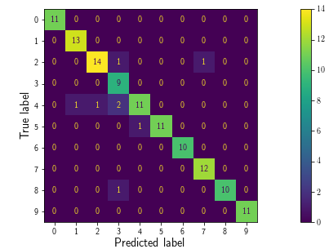
SVM classification with first-order synapses
Confusion Matrix
Total number of spikes in each neuron of the reservoir is taken as the input.
SVM with linear kernel is used for classification.
Accuracy obtained is 93.33%.

Slide 21
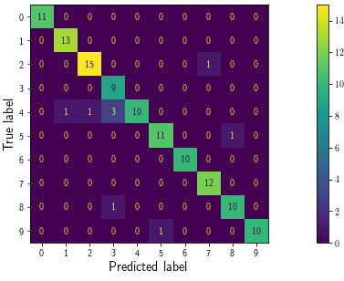
SVM classification with second-order synapses
Confusion Matrix
Total number of spikes in each neuron of the reservoir is taken as the input.
SVM with linear kernel is used for classification.
Accuracy obtained is 92.5%.

Slide 22
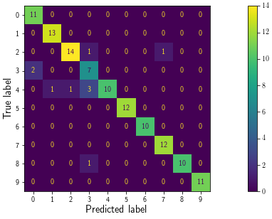
SVM classification on Input spike train
Confusion Matrix
Total number of spikes in each input neuron is taken as the input.
SVM with linear kernel is used for classification.
Accuracy obtained is 91.67%.

Slide 23
Conclusion
Using SVM Classifier on the output of reservoir provide increase of about 4-10% in accuracy as compared to SVM classification on input spike train.
SVM method shows high separability and performance for our choice of parameters

Slide 24
References
[1] Y. Zhang, P. Li, Y. Jin and Y. Choe, IEEE Transactions on Neural Networks and Learning Systems, vol. 26, no. 11, pp. 2635-2649, Nov. 2015.
[2] A. Gorad, V. Saraswat and U. Ganguly, 2019 International Joint Conference on Neural Networks (IJCNN), 2019, pp. 1-8
[3] Srinivasan G, Panda P and Roy K (2018) Front. Neurosci. 12:524.
[4] B. Schrauwen and J. Van Campenhout, Proceedings of the International Joint Conference on Neural Networks, 2003., 2003, pp. 2825-2830 vol.4.
[5] Y. Jin and P. Li, Neurocomputing (226 I45-160), 2017

